Slide 1
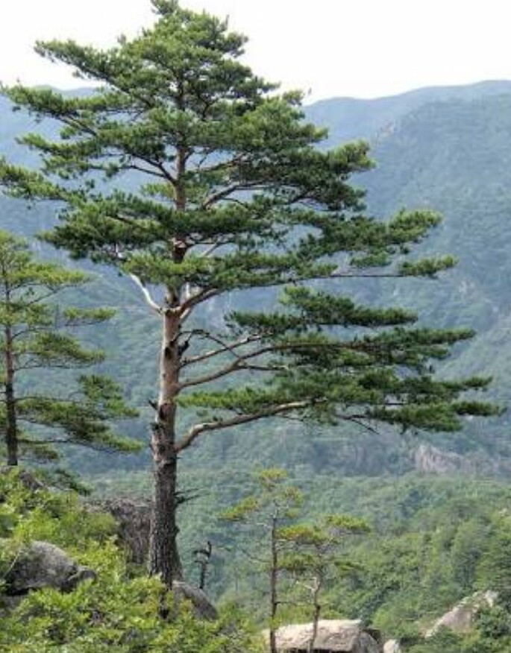
PRESENTATION
ON
PINUS

Slide 2
INTRODUCTION
Pinus are the conifer trees in the genus pinus
In the family panacea they are the only genus in the sub family pinodeae counting varieties and subspecies , the plant list of royal botanic gardens, kew and Missouri botanical garden accepts 175 names of pinus as current , together with some 30 or 40 unresolved and many more synonyms applied

Slide 3
DESCRIPTION
Pinus are evergreen coniferous trees groing3-80m tall with the majority of species reaching 114-45m tall .
The leaves are bright green in clusters of three slender , 8-15cm along and with blunt tip.
The bark of most pinus is thick and scaly , but some species have thin , flaky bark.
The cones are 7-17cm long , brown , ovoid .
Pinus are long-lived , typically reaching ages of 100-1,000 years.
The longest living is the great basin bristlecone pine aqw3

Slide 4
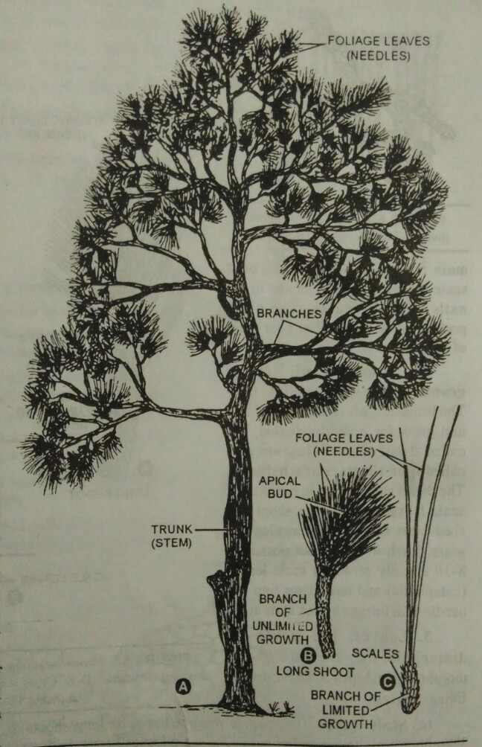
EXTERNAL CHARACHTERS
The plants are tall trees are reaches upto3-50m in height.
They are perennial , evergreen and xerophytes .
They appear pyramidal or conical due to radial branching.
The sporophytic plant body is differentiated into :
Stem
Root
Leaves

Slide 5
ROOT
The primary root is tap root which does not grow very deep into the soil .
Root hairs are scanty and found in very young roots.
They are soon replaced by autotrophic Mycorrhiza ,this association is belived to be symbiotic .
Fungus helps roots in the absorption of nutrients and also protects them from pathogens.

Slide 6
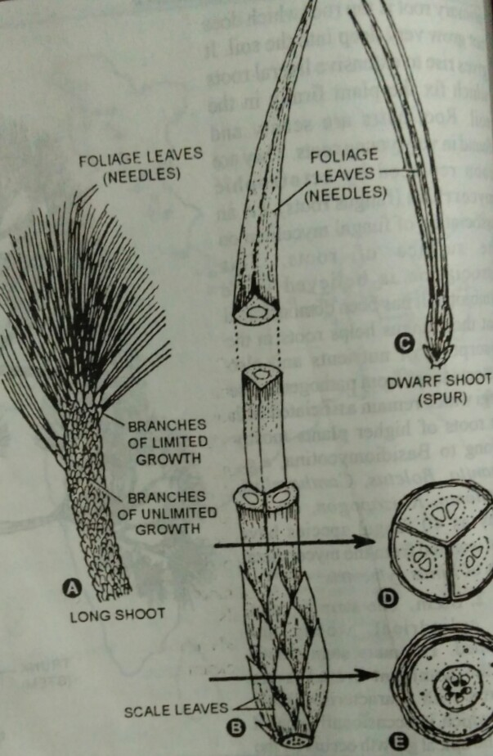
STEM
The stem erect , tall , cylindrical woody and branched.
The apical growth occurs by a large apical bud .
The branches arise laterally and spirally from the axils of scale leaves.
The branches are Dimorphic :
Branches of unlimited growth
Branches of limited growth
BRANCHES OF UNLIMITED GROWTH : The branches which grow for unlimited period , are called long shoots . These branches are arranged spirally on the main trunk . The branches bears scale leaves.
BRANCHES OF LIMITED GROWTH : The branches which lacks apical bud and grow for a shorter period are called Dwarf shoot . Each dwarf shoot possesses 8-10 spirally arranged scale leaves.

Slide 7
LEAVES
The leaves are dimorphic i.e. the are two types
Scale leaves
foliage leaves
Scale leaves : They are thin , brown, flattened and minute. The scale leaves are born on long shots as well as on dwarf shoots. The main function of scale leaves is to protect the young buds . They are not photosynthetic
Foliage leaves : they are long acicular and needle like structure generally in green color. They born only on dwarf shoots.

Slide 8
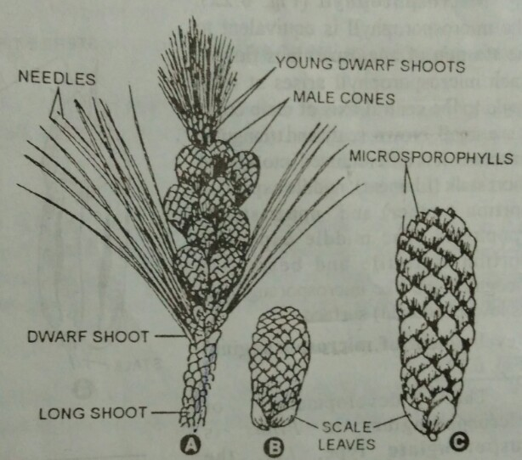
Reproduction:
The pinus plant are heterosporous.
Microspores are produced in microsporangia born on male cones
Megaspores are produced in microsporangia born on female cones.

Slide 9
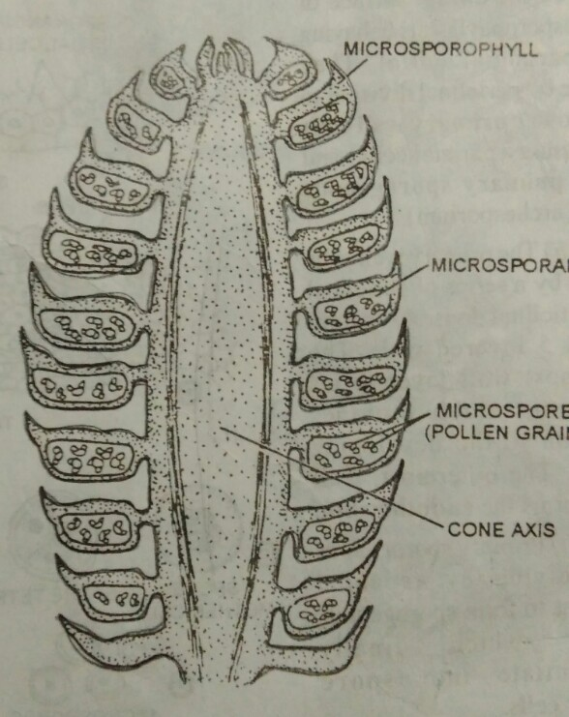
MALE CONES
The male cones of pinus are also known as male strobili or staminate cones .
They appear in the month of March-April in hills and in January in plains.
They arise on the branch of unlimited growth .
Male cone is small and ovoid structure .
It varies from 2-4cm in length and 5-6mm in diameter .
It is pale yellow in color.

Slide 10
STRUCTURE OF MATURE MICROSPORANGIUM
Mature microsporangium is small, sessile and elongated sac .
It is pale brown in color.
The tapetum layer is disintegrates during maturation of spores.
The spore sac is filled by pollen grains
DEHISCENCE OF MICROSPORANGIUM :
Each microsporangium has a longitudinal line . In hot dry whether the wall of sporangium cracks through this line. A large number of pollen grains are released through this line and dispersed in air. These spores are shed in huge amount that they form yellow clouds . This feature is called shower of sulphar dust in the Himalayan pine forests.
The pollen grain are generally released in months of march to beginning of june and travel to long distances the empty pollen grains wither and dry cones fall off from the trees.

Slide 11
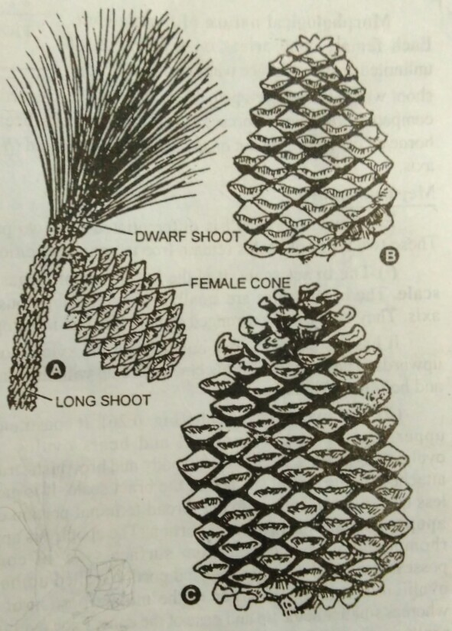
FEMALE CONES
The female cones of pinus are also called ovulate strobili .
They appear in the months of February in plains and May in the hills.
Each female cones arises in the place of dwarf shoot .
Each female cone takes three years to get mature and set seeds.
The first year cones are comparatively small , compact and reddish green in color .
The second year cones are comparatively large ,they become slightly woody.
The third year cone are large and woody .
They develop seeds at the end of third year.
They are elongated cylindrical shape and 15-20 cm long.

Slide 12
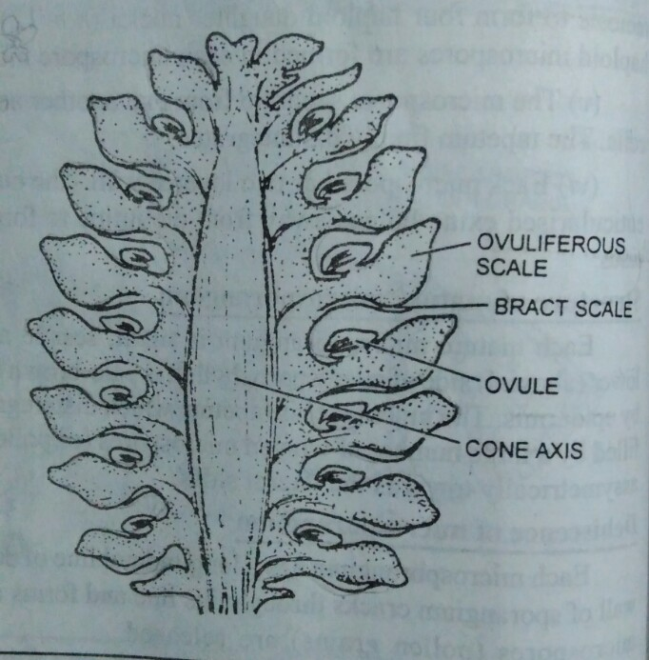
MEGASPOROPHYLL :
Each megasporophyll is differentiated into two parts :
Bract scale
ovuliferous scale
The Bract scale: It is lower part of megasporophyll . It is called carpellary .
They are small , dry and membranous structures attatched on central axis.
The ovuliferous scale : the upper part of megasporohyll bears ovules.
Each ovuliferous scale is thick , woody and brownish structure.
It’s broad terminal portion called apophysis and a small central projection , called umbo.

Slide 13
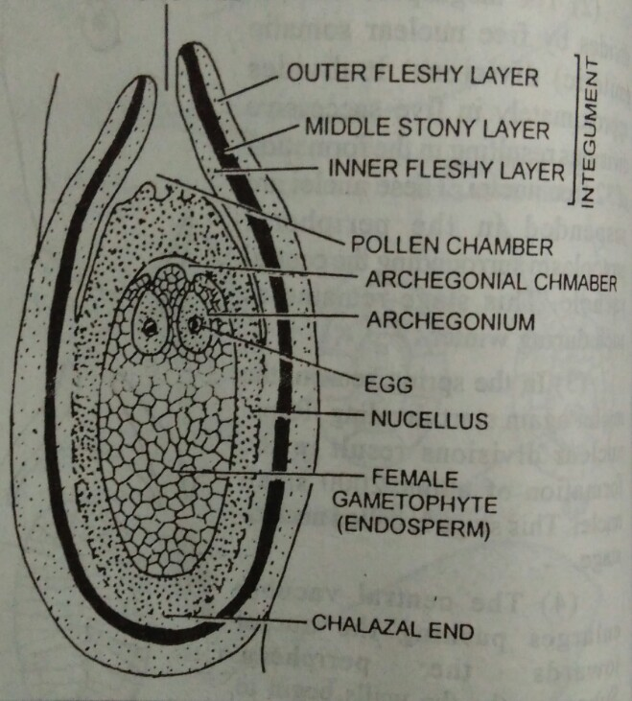
STRUCTURE OF OVULE :
The mature ovule is oval in shape and attached laterally on the upper surface of ovuliferous scale.
The central part of ovule contain nucellus .
The nucellus is covered by thick protective covering called integument.
STRUCTURE OF MATURE OVULE BEFORE FERTILIZATION :
Mature ovule of pinus is oval in shape and attached laterally on the surface of ovuliferous scale. The nucellus is fused with the inner layer of integument . The cells of nucellus surrounding the female gametophyte differentiate to forn 2-3 layers of nutritive tissue , called spongy layer.
It Is haploid. The micropylar end bears archegonia . Each archegonia has 8 neck cells arranged in 4 tiers of 2 cells each . The neck canal cells are absent.

Slide 14
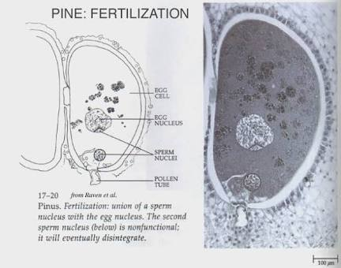
FERTILIZATION
Fertilization occurs about 12-14 months after pollination, during May –June of the second year.
Mature male gametophyte consist along pollen tube containing two unequal non flagellated male gametes ,
The tube acts as carrier of gametes.
After reaching at apex of female gametophyte the tube enters into archegonium through neck .
The male gametes show ameboid movement and finally one of the m fuses with the egg becomes Zygote.
The haploid nucleus of male gametes fuses with the haploid (n=12 ) nucleus of egg to form diploid (2n=24) nucleus of zygote.
The zygote acts as the first cell of sporophytic generation.

Slide 15
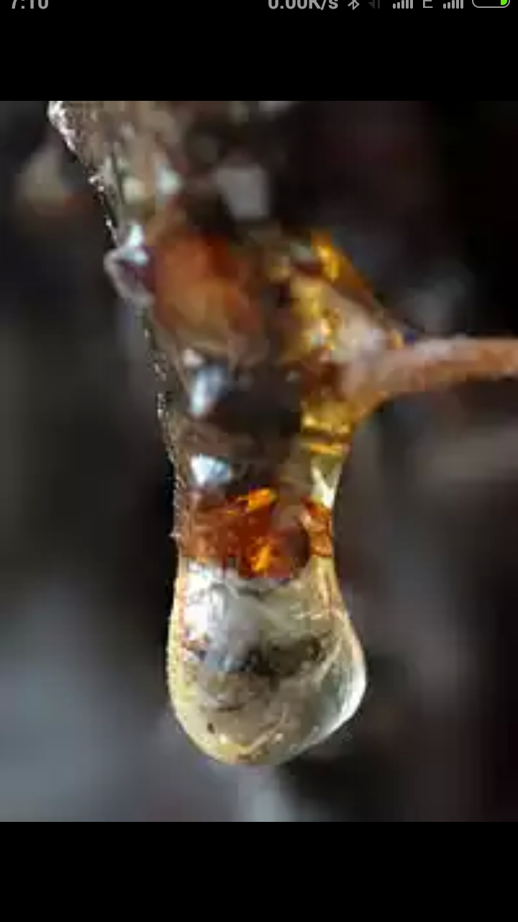
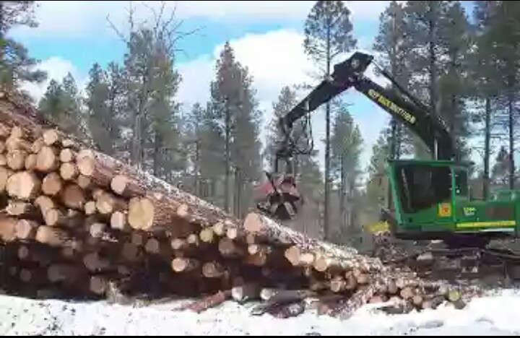
ECONOMIC IMPORTANCE OF PINUS
The most importance product obtained from pine forests is Timber .as the wood of pinus is pycnoxylic , it provides valuable timber for building and other construction purpose .
Species of pinus also yield many resins , oils and turpentine which are of great value.
Resins are used in varnish making , enamels and in the preparation of soap , paints , oil clothes etc.
The seed of p. gerardiana aare commonly called chilgoza they are used as highly nutritious dry fruits.
The wood and female cone of pinus are used as fuel.
Pinus are grown in the gardens and parks as ornamentals.

Slide 16
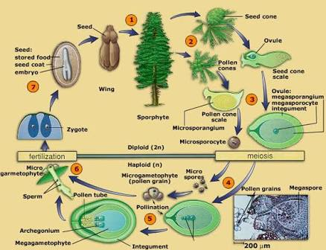
LIFE CYCLE

Slide 17
THANKS

